Slide 1
Setting up an effective team Team Profiles Team Management Systems

Slide 2


Slide 3
TMS is…
Evaluating work preferences for a team
8 functions
People become aware of their interactions
Teams may realize where a function is “missing”
TMS enables teams to find balance and purpose

Slide 4
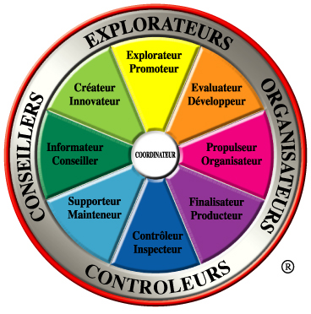
TMS Presentations
The individual
Where do you get your energy from?
What are your strong points when you work in a team?
How do you react when you face change and unexpected situations?
The team
What does each individual think about the team’s performance?
Are there any gaps?
What are the points we need to focus on?
The function
Do we have a clear view
of our job?
What are our critical priorities?
Does your energy suit your role?

Slide 5
The TMS Model
Explorers
Promoter
Creator
Developer
Advisors
Organizers
Advisor
Linker
Organizer
Maintainer
Producer
Inspector
Controllers

Slide 6
Starting up a team
Newly appointed manager of sales team
Struggling to organize the team

Slide 7
The TMS Model
Sales Director strong on Promoting
Explorers
Promoter
Creator
Developer
Advisors
Organizers
Advisor
Linker
Organizer
Maintainer
Producer
…But the boss wants this!
Inspector
Controllers

Slide 8
Skewed Team
Promoter
Explorers
Creator
Developer
Advisors
Organizers
Advisor
Linker
Organizer
Maintainer
Producer
Inspector
Controllers

Slide 9
Recommendations
Assign to adjacent roles.
Allow them to experiment with them.
Identify champions who adapt well
Remove obstacles to learning

